Slide 1


Phisher.ai
Muhammad Ramish Khan 2019358
Muhammad Saaim Qureshi 2019444
Muwahid Asim 2019352
Abdul Basit Khan 2019004
Supervisor
Dr. Farhan Khan
Co-supervisor
Mr. Talha Laique
Faculty of Computer Sciences and Engineering Ghulam Ishaq Khan Institute of Engineering Sciences and Technology, Pakistan

Slide 2
Evaluation Criteria
Rubrics | PLO3 | PLO4 | - | Marks
Requirements Gathering Methodology |  | ✓ |  | 5
Requirements Specifications |  | ✓ |  | 10
Proposed Design | ✓ |  |  | 10
Requirements were mapped to the design adequately | ✓ |  |  | 5
Division of Tasks / Use of Project Management Tools | - | - | ✓ | 10

Slide 3
Introduction
The increase in internet use has shifted people to send data through online platforms and communicate on social media platforms. Whenever the internet is involved, there is the involvement of threats. The most common threat is phishing, which has caused considerable losses to individuals and large companies.

Slide 4
Project overview- Proposed Solution
In this modern digital age, the number of phishing attacks has increased massively, and we aim to find a solution which help us detect the phishing emails before any harm is done.
There are multiple approaches to tackle the problem to phishing. Our proposed solution consists of using DEEP LEARNING APPROACH to identify phishing emails.

Slide 5
LITERATURE REVIEW

Slide 6
SIGNATURE BASED and ANAMOLY BASED
Signature based phishing detection system makes use of signatures of known phishing emails to compare against the unknown email.
Anomaly based phishing detection system works by taking a baseline of the normal and valid emails. They can measure the current emails against this baseline to detect patterns that are not present in the email normally.

Slide 7
URL BASED DETECTION
List-based detection
List-based phishing detection methods use either whitelist or blacklist-based technique.
whitelist is a list of legitimate domains, URLs, and IP addresses used to validate a suspected URL
A blacklist contains a list of suspicious domains, URLs, and IP addresses, which are used to validate if a URL is fraudulent
Wang, Y., Agrawal, R., & Choi, B.Y. Light weight anti-phishing with user whitelisting in a web browser. in Region 5 conference, 2008 IEEE, IEEE, 1–4 [12]
Han W, Cao Y, Bertino E, Yong J. Using automated individual white-list to protect web digital identities. Expert Syst. Appl. 2012;39(15):11861–11869. doi: 10.1016/j.eswa.2012.02.020 [13]
Jain AK, Gupta BB. A novel approach to protect against phishing attacks at client side using auto-updated white-list. EURASIP J. on Info. Security. 2016;9:1–11. doi: 10.1186/s13635-016-0034-3 [14]

Slide 8
URL BASED DETECTION
MACHINE LEARNING BASED
Sahingoz et al [1] | Use NLP based features, word vectors, and hybrid features, and then seven different machine learning algorithms are used to classify the URLs | A public dataset of 36,400 benign URLs and 37,175 phishing URLs | 97.98% accuracy rate with RF
Rao et al. [2] | This technique proposes manually crafted URL features and TF-IDF based features and with the use of these features classifies the URLs by using random forest classifier | A public dataset of 85,409 benign URLs and 40,668 phishing URLs | TFIDF and hand-crafted features achieved accuracy of 94.26%
A. Lakshmanarao et al [7] | TF-IDF, Count and Hash vectorizer then different machine learning Algorithms (KNN, RF, DT, Logistic Regression) | Kaggle dataset with a large number of URLs (above 5,00000 URLs) | hash vectorizer and RF achieved 97.5% accuracy.

Slide 9
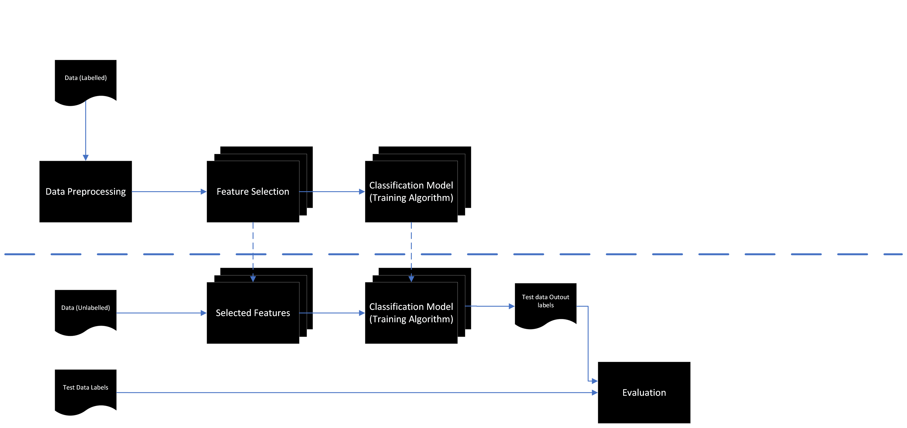

Previous Approach

Slide 10
URL BASED DETECTION
DEEP LEARNING BASED
Although deep learning techniques are not exploited much in phishing detection due to the extensive training time, they often provide more accuracy and automatically extract the features from raw data without any prior knowledge

Slide 11
URL BASED DETECTION
DEEP LEARNING BASED
Zheng et al. [5] | Proposed a new Highway Hierarchical Neural Network (HDP-CNN) to detect phishing URLs. | This method uses word-level embedding along with character-level | A private dataset contains 344,794 benign URLs and 71,556 phishing URLs | Accuracy at 98.30%, True positive rate (TPR) at 99.18% True negative rate (TNR) at 94.34%.
Le et al. [4] | This technique applies CNN networks to both characters and words of the URL string for malicious URL detection | characters and words encodings | A private dataset of 4,683,425 benign URLs and 9,366,850 malicious URLs | AUC score 99.2%
Vargas, J et al. [6] | compared a random forest classifier against recurrent neural networks based on a hand-crafted features method. | Character encoding for RNN | phishing URLs from Phishtank Legitimate URLs from Common Crawl | AUC statistic of 98.44% Accuracy : 93.47% recall : 93.28% precision : 93.63%
Wang et al [15] | proposed a fast-phishing website detection method called precise phishing detection with recurrent convolutional neural networks (PDRCNN) that depends only on the URL of the website | Data preprocessing is based on word embedding | 5,118,727 URL from PhishTank website 245,385 valid phishing | Accuracy of 97% AUC value of 99%

Slide 12
EMAIL CONTENT BASED
Adwan Yasin et al [8] | The model applied the knowledge discovery procedures using five popular classification algorithms J48, Naïve Bayes, Support Vector Machine (SVM), Multi-Layer Perceptron and Random Forest. | TFIDF/COUNT VECTORIZOR | 4598 spam emails from Nazario phishing corpus and 5940 ham emails from spam assassin project | 99.1% accuracy was achieved using the Random Forest algorithm and 98.4% using J48,
Ioannis Agrafiotis et al [9] | phishing content classifier based on a recurrent neural network (RNN) | Word encoding | 9 962 phishing emails Nazario phishing corpus and 10 000 emails from the Enron dataset | 96.74 % accuracy 97.45 % precision 95.98 % Recall
Molly Dewis et al [10] | The technique involves the use of RNN model on both the textual email data and Numerical data. | TF-IDF | TEXT: Spam Assassin, Spam Classification for Basic NLP Spam Email Numerical : Spambase Email Spam Classification Dataset | average accuracy of 99% with the LSTM model for text-based datasets. average accuracy of 94% with the MLP model for numerical-based datasets
YONG FANG et al [11] | The technique based on on recurrent convolutional neural networks (RCNN) model with multilevel vectors and attention mechanism, | WORD2VEC | 7781 legitimate emails and 999 phishing emails from multiple sources, spam assassin, enron, Nazario corpus, wikileaks archive | overall accuracy reaches 99.848%

Slide 13
METRICS
ROC CURVE
AUC provides an aggregate measure of performance across all possible classification thresholds
Precision
The number of instances that are relevant, out of the total instances the model retrieved
Recall
The number of instances which the model correctly identified as relevant out of the total relevant instances
Accuracy
The number of correctly classified data instances over the total number of data instances.

Slide 14
Dataset Description

Slide 15
Monkey.org + Enron Email Dataset
RAW DATA
The first one is a large phishing corpus that contains about 2254 real phishing emails in a single mbox file from monkey.org
The second is a large database of 2254 real and non-phishing emails obtained from the Enron Email Database
The link to the phishing corpus was retrieved from other GitHub repository that studied phishing emails and used external manually extracted features for the classification

Slide 16
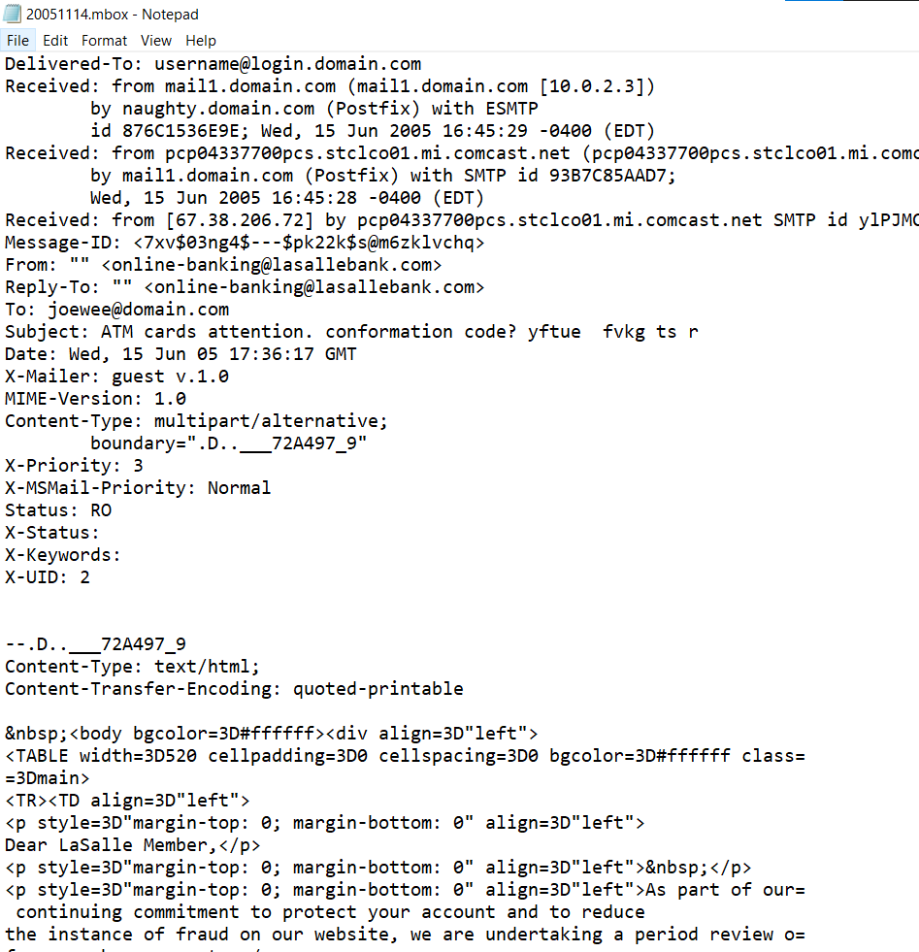
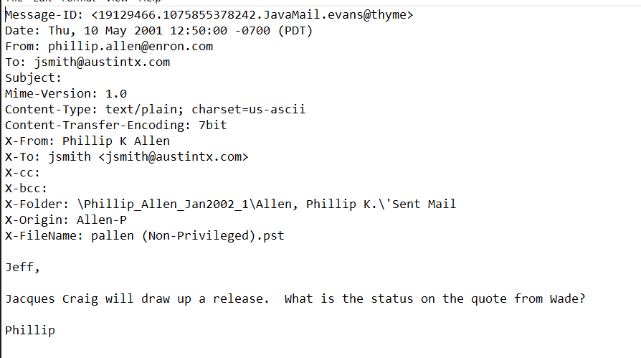
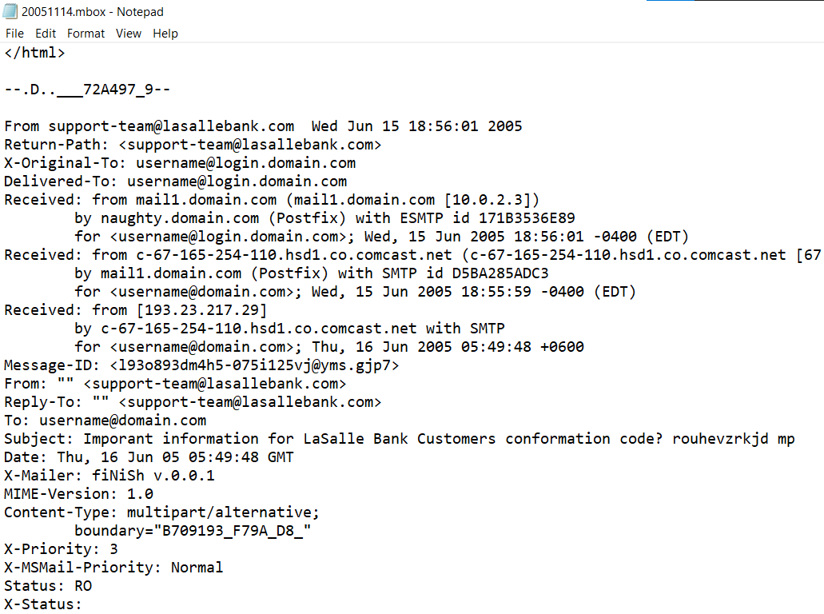
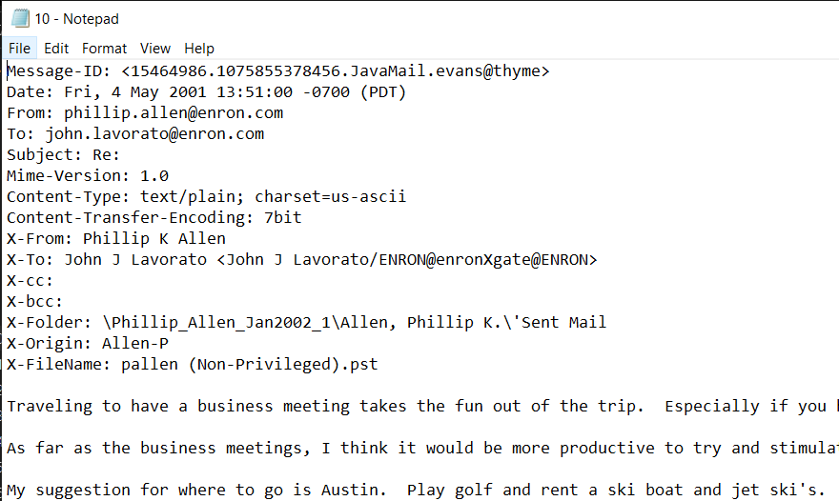
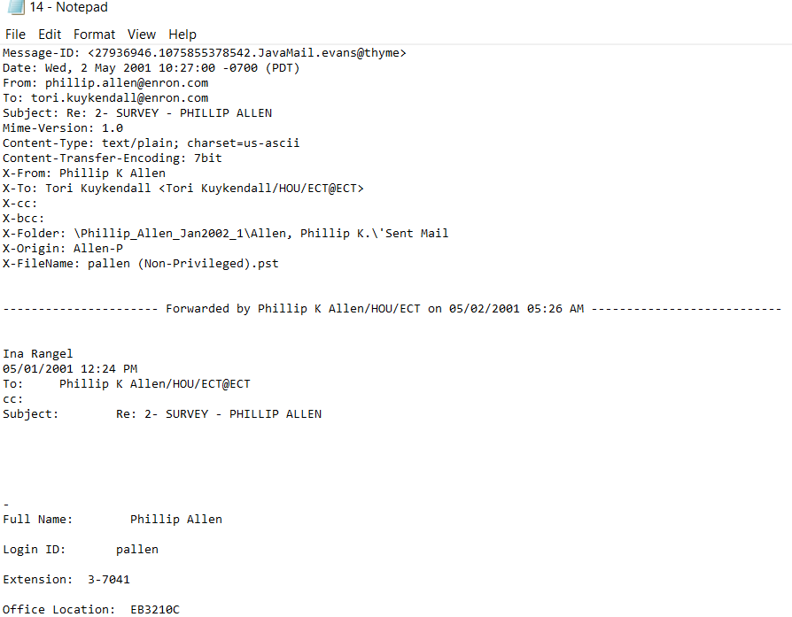
Monkey.org + Enron Email Dataset
Phishing emails monkey.org (single file)
Legitimate emails ENRON DATASET (multiple file)

Slide 17
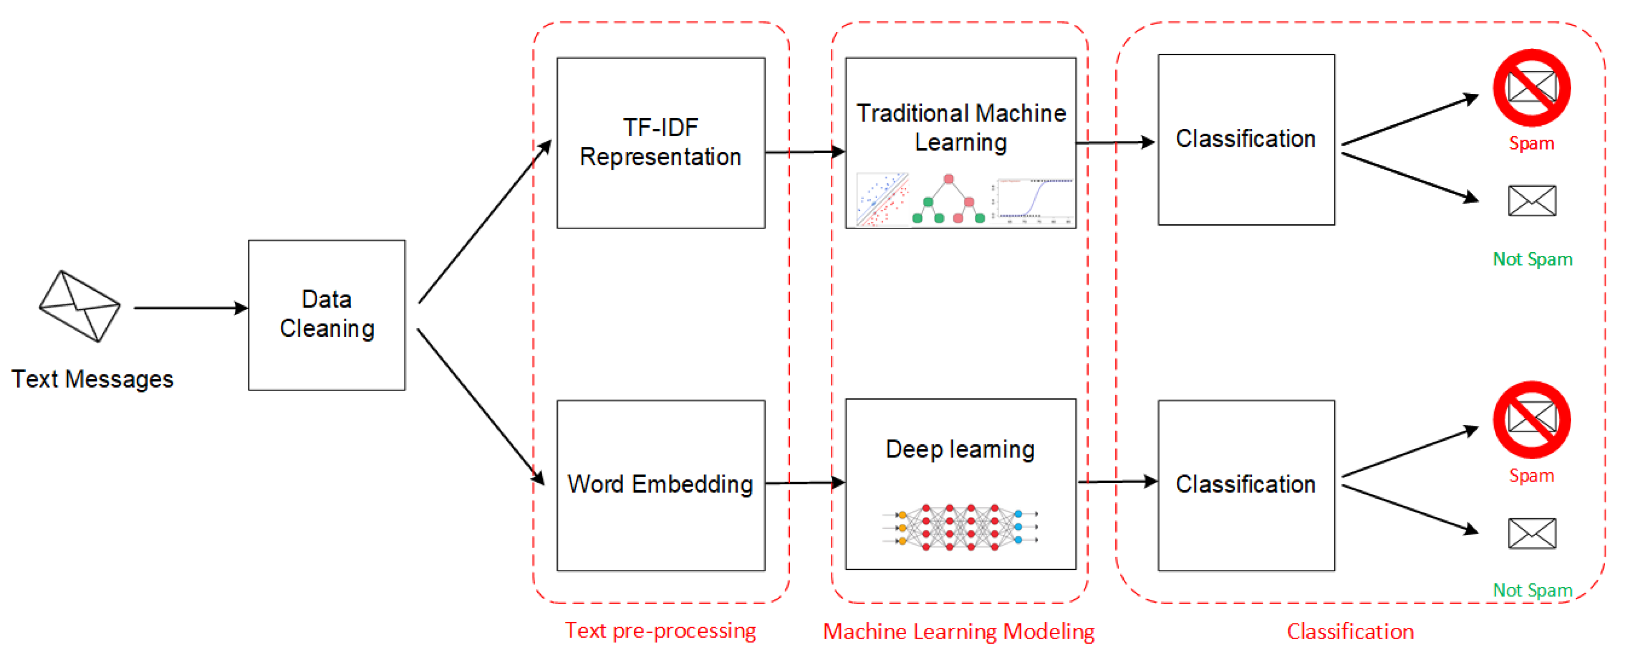
DATASET FLOW
Traditional ML vs DL
EMAILS
One-hot Encoding
https://www.mdpi.com/1999-5903/12/9/156

Slide 18
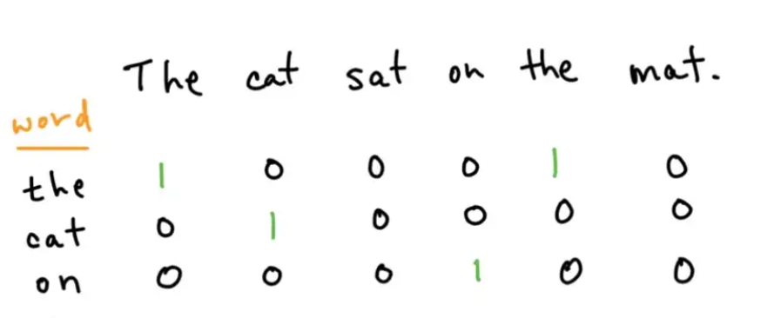
ENCODING
OUR PROCESS
Word wise encoding
Feature Extraction and Embeddings in Natural Language Processing (analyticsvidhya.com)
The size of the vocabulary would only grow as the training corpus gets larger and larger, as a result, each token would be represented by vectors with an increasingly larger length, making matrices sparser. Instead of word-level representations, a more common approach is to use characters as tokens since it’ll limit the length of the vectors.
ENCODING FOR 85 CHARACTERS WOULD BE USED A-Z, a-z, 0-9, and special characters used in URLs

Slide 19
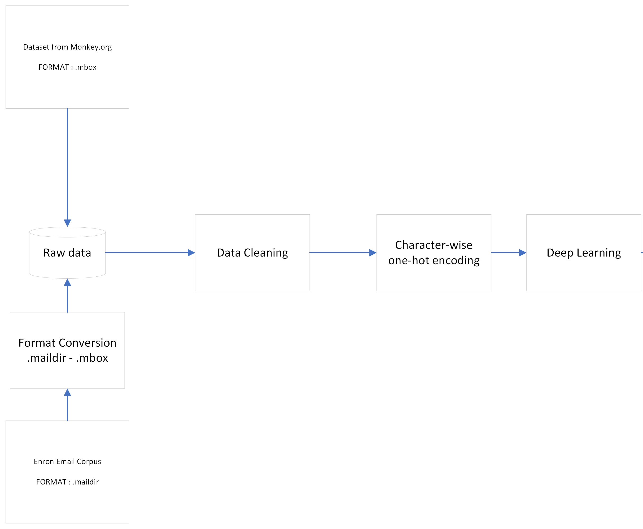
Training
Flow
training

Slide 20
HYPOTHESIS DEVELOPED

Slide 21
OUR PROCESS
Machine learning techniques have gradually become the standard for such classification problems. However, identifying common measurable features of phishing content (e.g., in emails) is notoriously difficult. To address this problem, we engage in a novel study into a phishing content classifier based on a recurrent neural network (RNN).

Slide 22
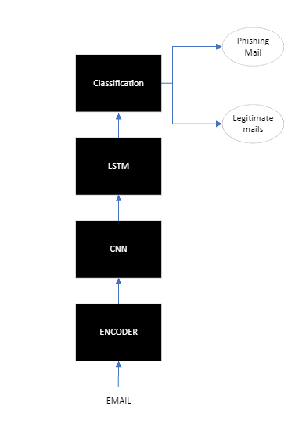
OUR PROCESS
We propose a series of neural network algorithms such as RNNs, CNNs and their combinations to generate a learning model
Further details are explained ahead

Slide 23
OUR PROCESS
The technique involves using CNN and RNN(LSTM) for the phishing email detection | 2000+ Phishing emails from monkey.org and 2000+ legitimate emails from ENRON dataset | Character Encoding | AUC, Precision, Recall, Accuracy

Slide 24
OUR PROCESS
Project - Assumptions & Constraints
Any character other than one’s in the 85 character won’t be encoded
Only classify emails of English Language

Slide 25
Requirement Specification

Slide 26
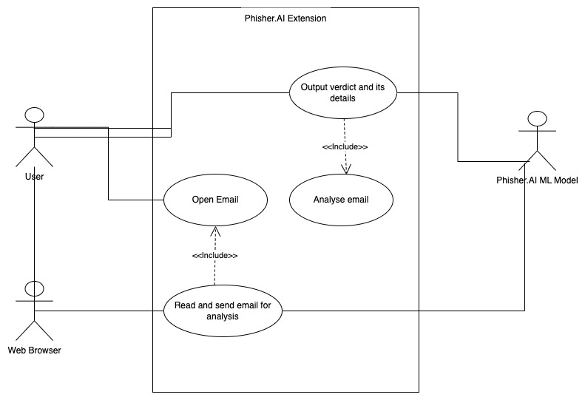
USECASE

Slide 27
Functional Requirement
FR | DESCRIPTION
FR1 | User can click on the extension to send the email content to the server
FR2 | The plugin should be able read the content of the mail
FR3 | Server should be able to process the data (Produce correct encoding)
FR4 | Server should Host the model and be able to perform processing on the data
FR5 | The server should be able to classify the mail as Phishy or not
FR6 | The server should be able to communicate back the results to the plugin
FR7 | Plugin should be able to display the results to the user

Slide 28
Non-Functional Requirement
Execution qualities
NFR | DESCRIPTION
Security | All communication between the Phisher.AI extension and our servers is end-to-end encrypted so that malicious interceptors cannot read sensitive emails of our users. We will also not store any plaintext emails on our servers.
Usability | Phisher.AI provides a simple and intuitive UI, which shows all information clearly.
Reliability | We will take preventative measures to reduce the possibility of our servers going down. We will also have backup servers in case a server does go down.
Compatibility | Phisher.AI extension must be compatible with all the major web browsers and should be able to detect phishing emails in email clients.
Performance | Our ML model is programmed as such that it runs efficiently, and our servers also have powerful GPUs to help the model perform complex calculations quickly.

Slide 29
Non-Functional Requirement
Evolution qualities
NFR | DESCRIPTION
Testability | We have a large portion of our dataset just for testing our ML model. And every time, we tweak our ML model, it is automatically tested using the test data.
Maintainability | We ensure that all of the code uses meaningful variable and function names. And the code uses comments to explain important variables, functions and classes.
Scalability | Phisher.AI is a scalable service, and so it will continue to help the growing number of users to defend against phishing attacks.

Slide 30
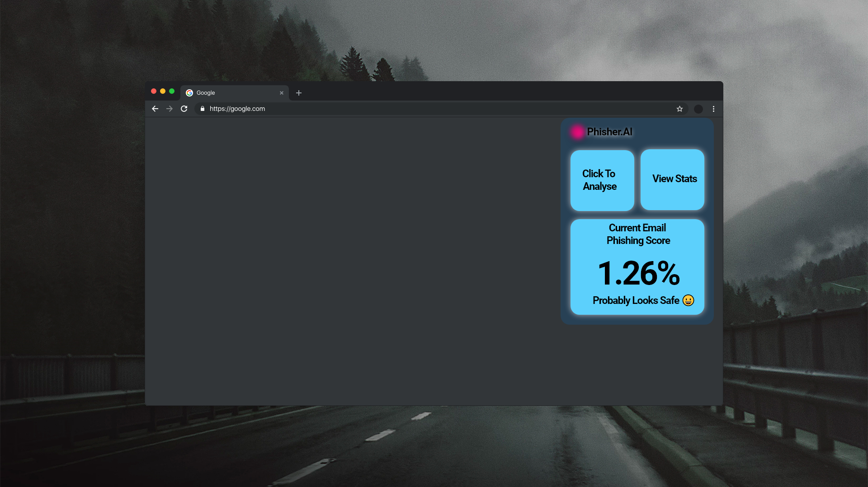
USER INTERFACE (EXTENSION)
PhisherAI icon
Results
Subject to change*

Slide 31
SYSTEM ARCHITECTURE

Slide 32
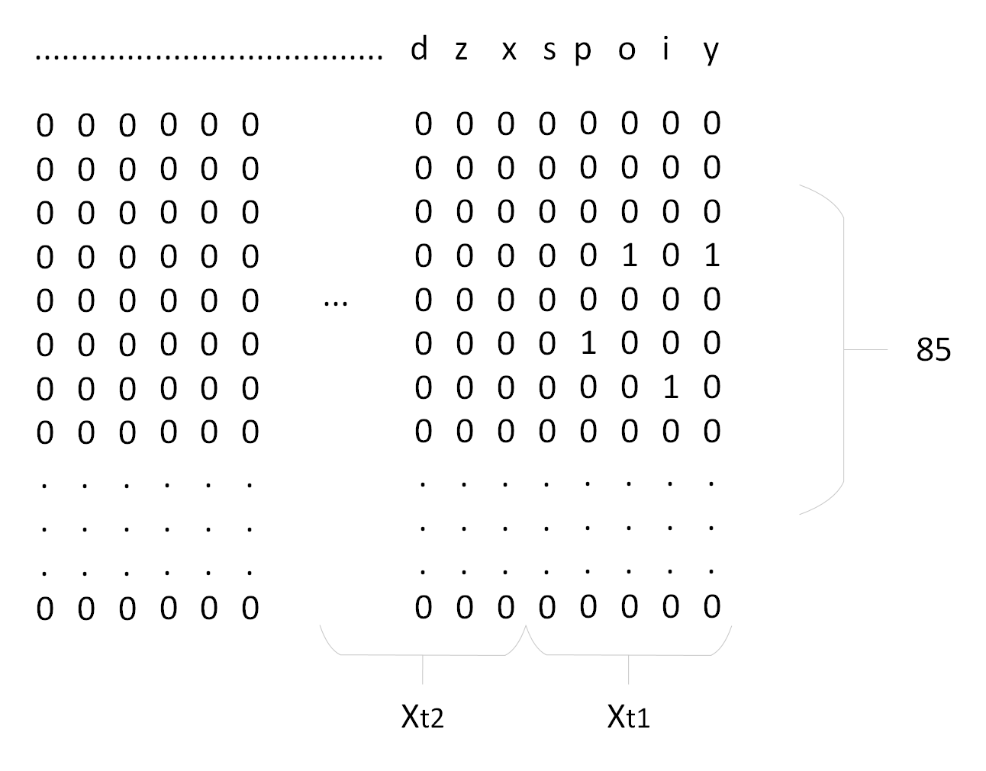
INPUT
Email’s content is character wise encoded
chunks of Xtn * 85 acts as input to the CNN (CONVOLUTIONAL NEURAL NETWORK)
Window slide (stride) = Xtn

Slide 33
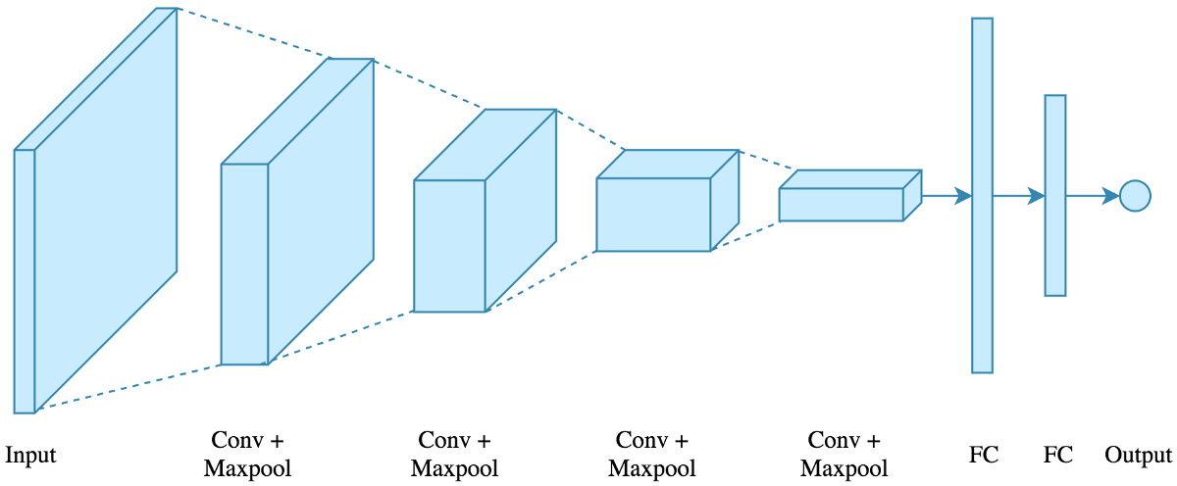
CNN (CONVOLUTION NEURAL NETWORK)
AT t1 : Xt1 * 85 would be fed into the neural network and the output is then provided to LSTM.
AT t2 : Window slides to the left and Xt2 * 85 would serve as the input of CNN
Fed to the LSTM
https://medium.com/@mayankverma05032001/binary-classification-using-convolution-neural-network-cnn-model-6e35cdf5bdbb

Slide 34
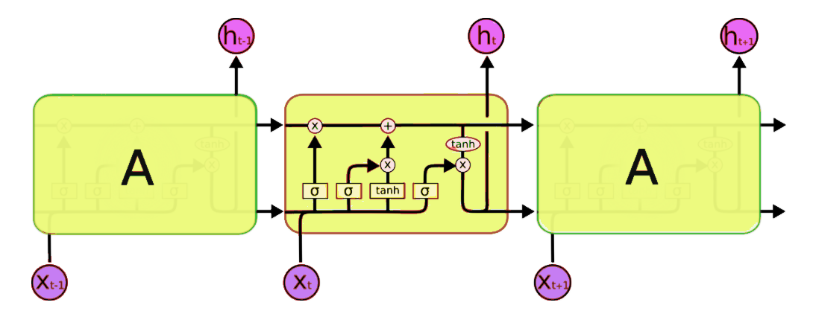
LSTM
For Sequential data, RNN is usually used. It can extract the sequential information from the input and to some extent contextual information as well.
LSTM based RNN have long term dependencies as they are connected to the previous output and current input
LSTM generates output as well as state to be passed to the next unit.
https://www.analyticsvidhya.com/blog/2017/12/fundamentals-of-deep-learning-introduction-to-lstm/

Slide 35
Project Workflow

Slide 36
PROJECT MANAGEMENT
9

Slide 37
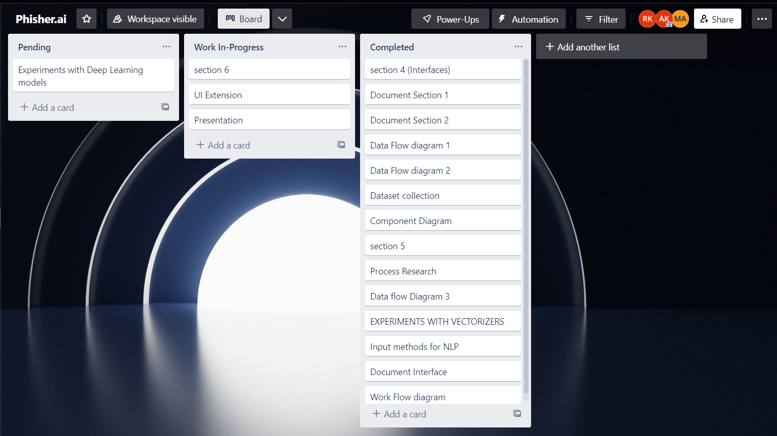
TRELLO
Used Trello for project management
Task division was done during our weekly meetings
We used lists to maintain the task that we’ve completed or we’re working on

Slide 38
REFERENCES
Sahingoz OK, Buber E, Demir O, Diri B. Machine learning based phishing detection from URLs. Expert Syst. Appl. 2019
Rao RS, Vaishnavi T, Pais AR. CatchPhish: Detection of phishing websites by inspecting URLs. J. Ambient. Intell. Humanized Comput. 2019
Aljofey A, Jiang Q, Qu Q, Huang M, Niyigena J-P. An effective phishing detection model based on character level convolutional neural network from URL. Electronics. 2020
Le, H., Pham, Q., Sahoo, D., & Hoi, S.C.H. Urlnet: Learning a URL representation with deep learning for malicious URL detection. arXiv 2018,
Zheng, F., Yan Q., Victor C.M. Leung, F. Richard Yu, Ming Z. HDP-CNN: Highway deep pyramid convolution neural network combining word-level and character-level representations for phishing website detection, computers & security 2021
Vargas, J.; Gonzalez, F.A. Classifying Phishing URLs Using Recurrent Neural Networks. In Proceedings of the 2017 APWG Symposium on Electronic Crime Research (eCrime), Scottsdale,
A. Lakshmanarao, M. R. Babu and M. M. Bala Krishna, "Malicious URL Detection using NLP, Machine Learning and FLASK," 2021 International Conference on Innovative Computing, Intelligent Communication and Smart Electrical Systems (ICSES), 2021
Yasin, Adwan & Abuhasan, Abdelmunem. (2016). An Intelligent Classification Model for Phishing Email Detection. International Journal of Network Security & Its Applications
Halgaš, I. Agrafiotis, and J. R. C. Nurse, “Catching the Phish: Detecting Phishing Attacks Using Recurrent Neural Networks (RNNs),” Information Security Applications
M. Dewis and T. Viana, “Phish Responder: A Hybrid Machine Learning Approach to Detect Phishing and Spam Emails,” Applied System Innovation, vol. 5, no. 4, p. 73, Jul. 2022.

Slide 39
REFERENCES
Y. Fang, C. Zhang, C. Huang, L. Liu, and Y. Yang, “Phishing Email Detection Using Improved RCNN Model With Multilevel Vectors and Attention Mechanism,” IEEE Access, vol. 7, pp. 56329–56340, 2019
Wang, Y., Agrawal, R., & Choi, B.Y. Light weight anti-phishing with user whitelisting in a web browser. in Region 5 conference, 2008 IEEE, IEEE, 1–4
Han W, Cao Y, Bertino E, Yong J. Using automated individual white-list to protect web digital identities. Expert Syst. Appl. 2012;39(15):11861–11869. doi: 10.1016/j.eswa.2012.02.020
Jain AK, Gupta BB. A novel approach to protect against phishing attacks at client side using auto-updated white-list. EURASIP J. on Info. Security. 2016;9:1–11. doi: 10.1186/s13635-016-0034-3
Wang, W.; Zhang, F.; Luo, X.; Zhang, S. PDRCNN: Precise Phishing Detection with Recurrent Convolutional Neural Networks. Secur. Commun. Netw. 2019,

Slide 40
THANK YOU!

